Slide 1
Bringing Dynamic Back

Slide 2
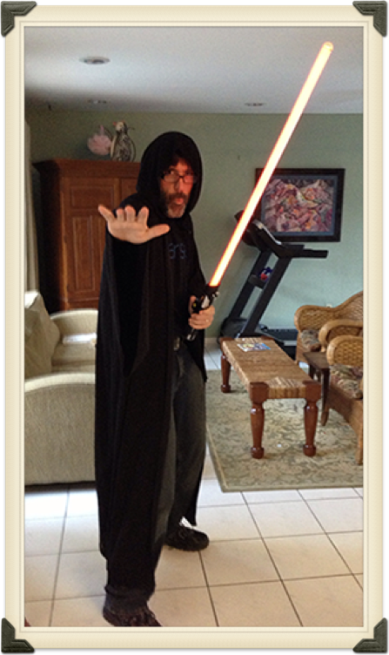
Raymond Camden
Developer Advocate for IBM
LoopBack, OpenWhisk, Apache Cordova/PhoneGap, Node, and web stuff in general
Blogging at raymondcamden.com
Tweeting at @raymondcamden

Slide 3
Game Plan

Slide 4
What are static sites?

Slide 5
Static Sites
Just files (HTML, CSS, JS)
No application server
No database
Nothing fancy

Slide 6
Useful for...
Docs
Stores (that aren't doing ecommerce)
Blogs
"Brochure-ware"

Slide 7
What are static site generators?

Slide 8
SSGs
They make static sites!
They give you a dynamic app server locally (typically using template languages like Markdown, Jade, SASS, etc)
They give you a way to work with data (without a database)
They output to static

Slide 9
Options
Jekyll, Hugo, Harp, etc
https://www.staticgen.com
https://staticsitegenerators.net

Slide 10
Demo

Slide 11
“Why in the heck would I not use an application server?????”
- Every developer ever

Slide 13
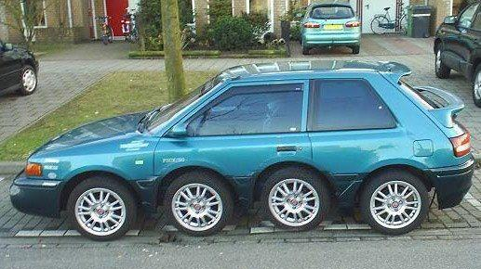

Slide 14
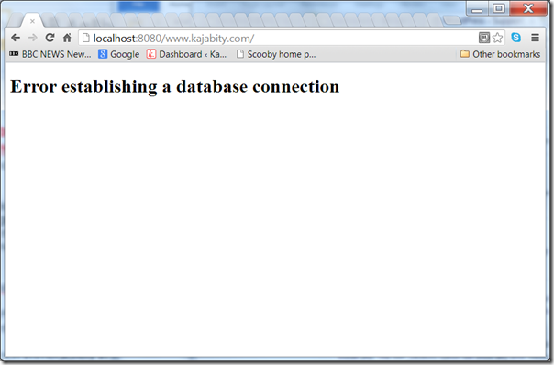

Slide 15

Notes:
as a developer - when I think of Heaven - I think of less crap to worry about
the fewer moving parts - the fewer chances for things to break

Slide 16
You've Gone Static!

Slide 17
“Hey, I know I said I didn't need this, but...”
-Every client ever

Slide 18
Dynamic Stuff you may miss
Forms
Comments
Search
Calendar
"Other Stuff"

Slide 19
Forms
WuFoo
3 forms, 100 submissions per month, 10 fields (free tier)
Google Doc
no limit
Formspree (https://formspree.io)
1000 submissions per month
FormKeep (https://formkeep.com)
no free tier (but a trial)
mailto (ok - technically not a form but...)
Notes:
FK has web hooks

Slide 20

Notes:
demos: formspree1.html
raymondcamden.com
javascriptcookbook.com

Slide 21
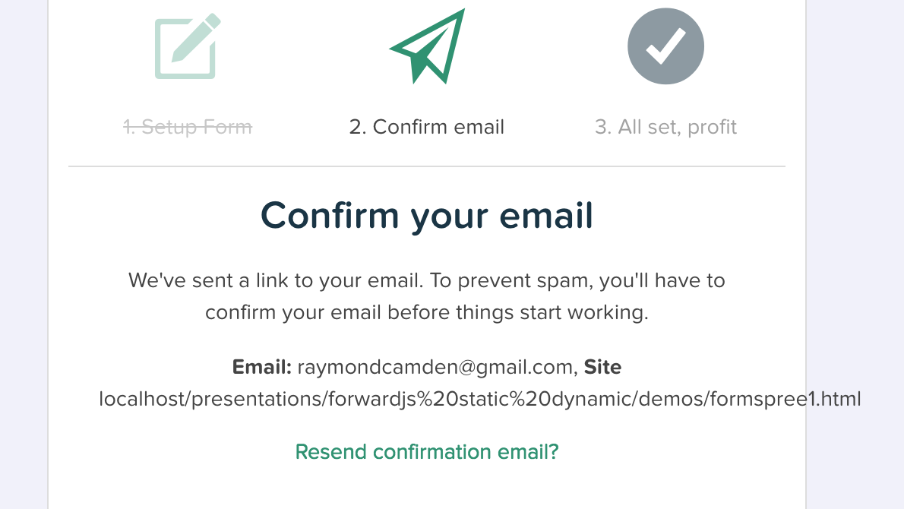

Slide 22
More Demos
Show WuFoo
http://www.javascriptcookbook.com/submit.html
http://www.coldfusionbloggers.org/contact

Slide 23
Comments
Disqus
Livefyre (Resting safely at Adobe)
Facebook Comments
Or hell - no comments

Slide 24
Notes:
my blog, javascript cookbook, talk about disqus issues

Slide 25
Search
Google Custom Search Engine
https://cse.google.com/cse/all
Tapir (tapirgo.com)
Notes:
If your feed is dead for 5 days, you get killed. No searches for 30 days - dead.

Slide 27
Calendars
Google Calendar
FullCalendar (http://fullcalendar.io)
EventBrite (**)

Slide 29
More Stuff!

Slide 30
"Data"
Parse
(haha, just kidding)
Firebase
PouchDB

Slide 31
“Do a Google Image search for 'possibly a bad idea'”
-Raymond Camden

Slide 32
CMS Solutions
CloudCannon
Netlify CMS
Jekyll Admin
Forestry.io
Roll your own

Slide 33
Final Thoughts
View your site with JavaScript turned off
(Probably a good idea in general, static site or not)
View your site with ad blockers, privacy doohickies, etc
(ditto)
Be real careful with free tiers

Slide 34
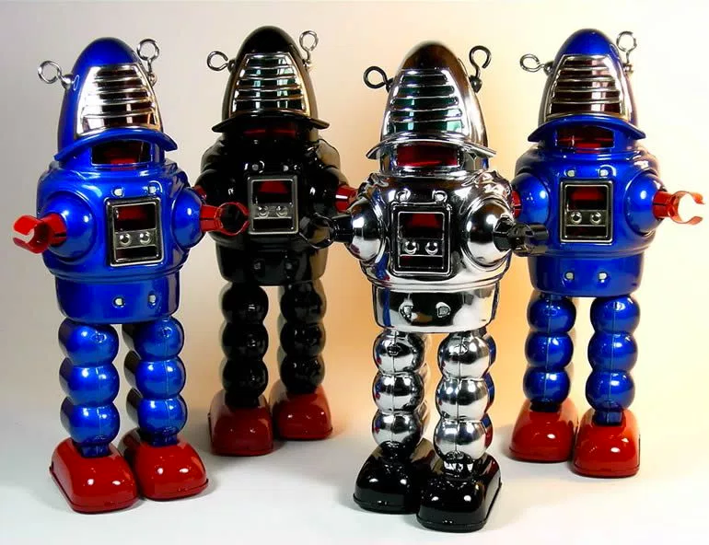
The Written Version
http://modernweb.com/2013/12/16/moving-to-static-and-keeping-your-toys

Slide 35
The Other Written Version
http://shop.oreilly.com/product/0636920051879.do

Slide 36
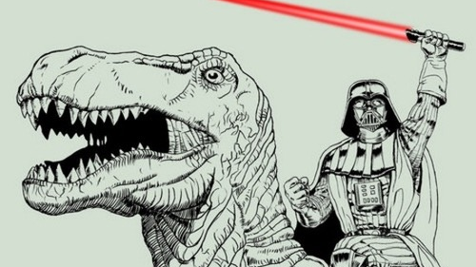
Thank you!

